Slide 1
THz Ryegrass Hydration Measurement
16-April Report
Reporter: Jialu Xing
Supervisor: Dominik Vogt

Slide 2
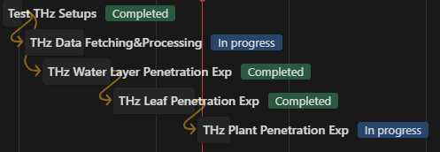
Overall Progress
API data issue still exist, but we can move on with a current approach
Current experiment

Slide 3
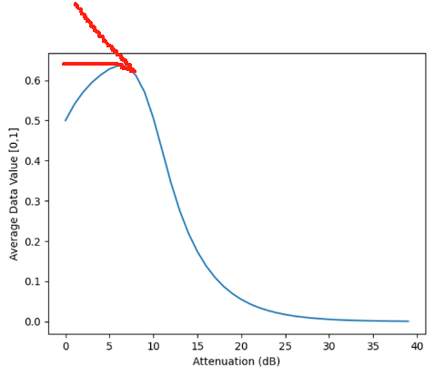
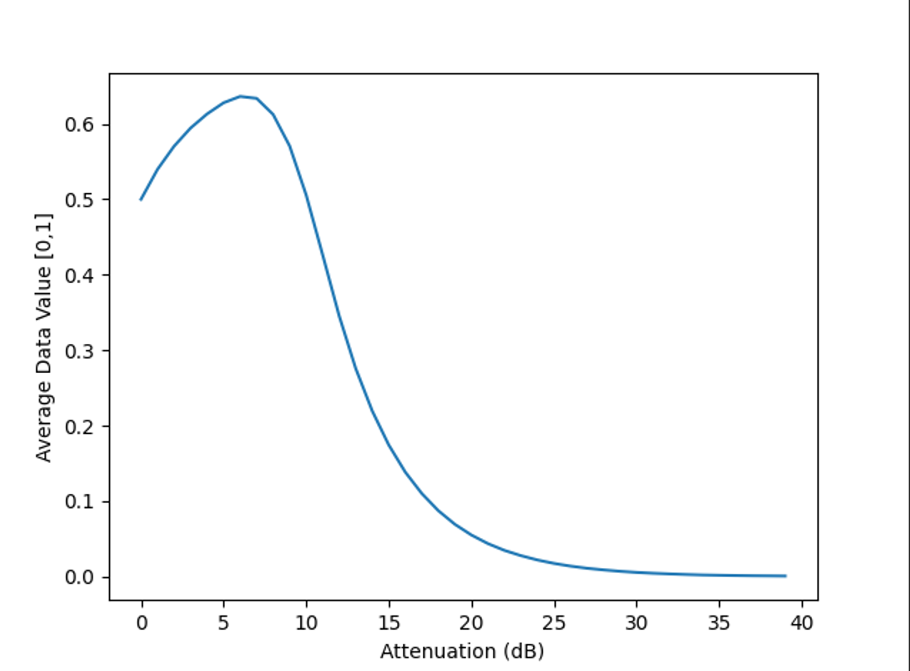
Recap: Pixel Value Data Issue
Real figure
Expected figure
The average pixel value against the source attenuation

Slide 4
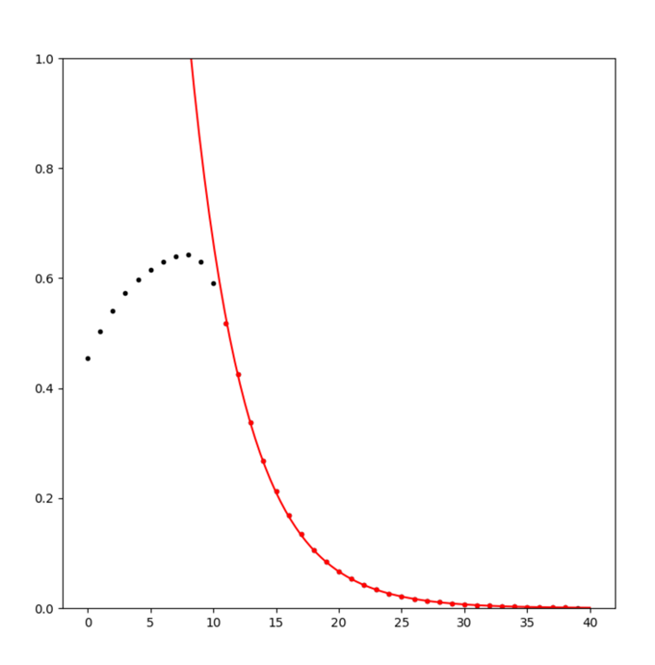
Recap: Pixel Value Data Issue
We fitted the I=I_0*10^(-dB/10) to the attenuation measurement.
To see if the fitted value is identical with the former plots
curve fit plot

Slide 5
Recap: Pixel Value Data Issue
Data is invalid when pixel value exceed 0.5.
Reply from Terasense：
“The effect you observe may be the result of extreme overload.”
“The drop of the signal in the overload that you observe would in the extreme case cause the observed "signal" to drop all the way to zero.”
Pixel value exceed 0.5 indicate that the pixel is saturated.
curve fit plot

Slide 6
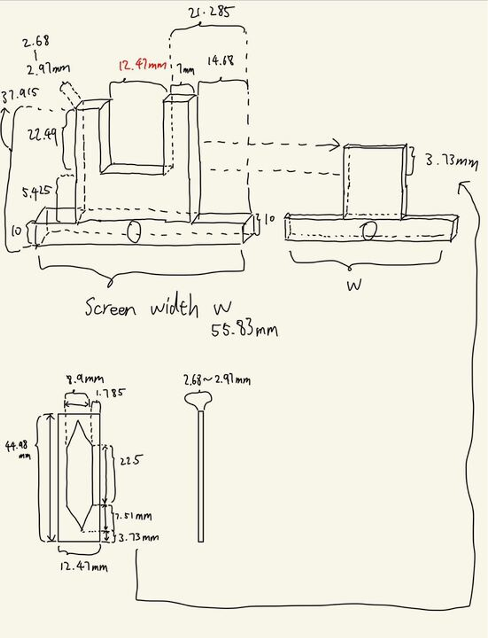
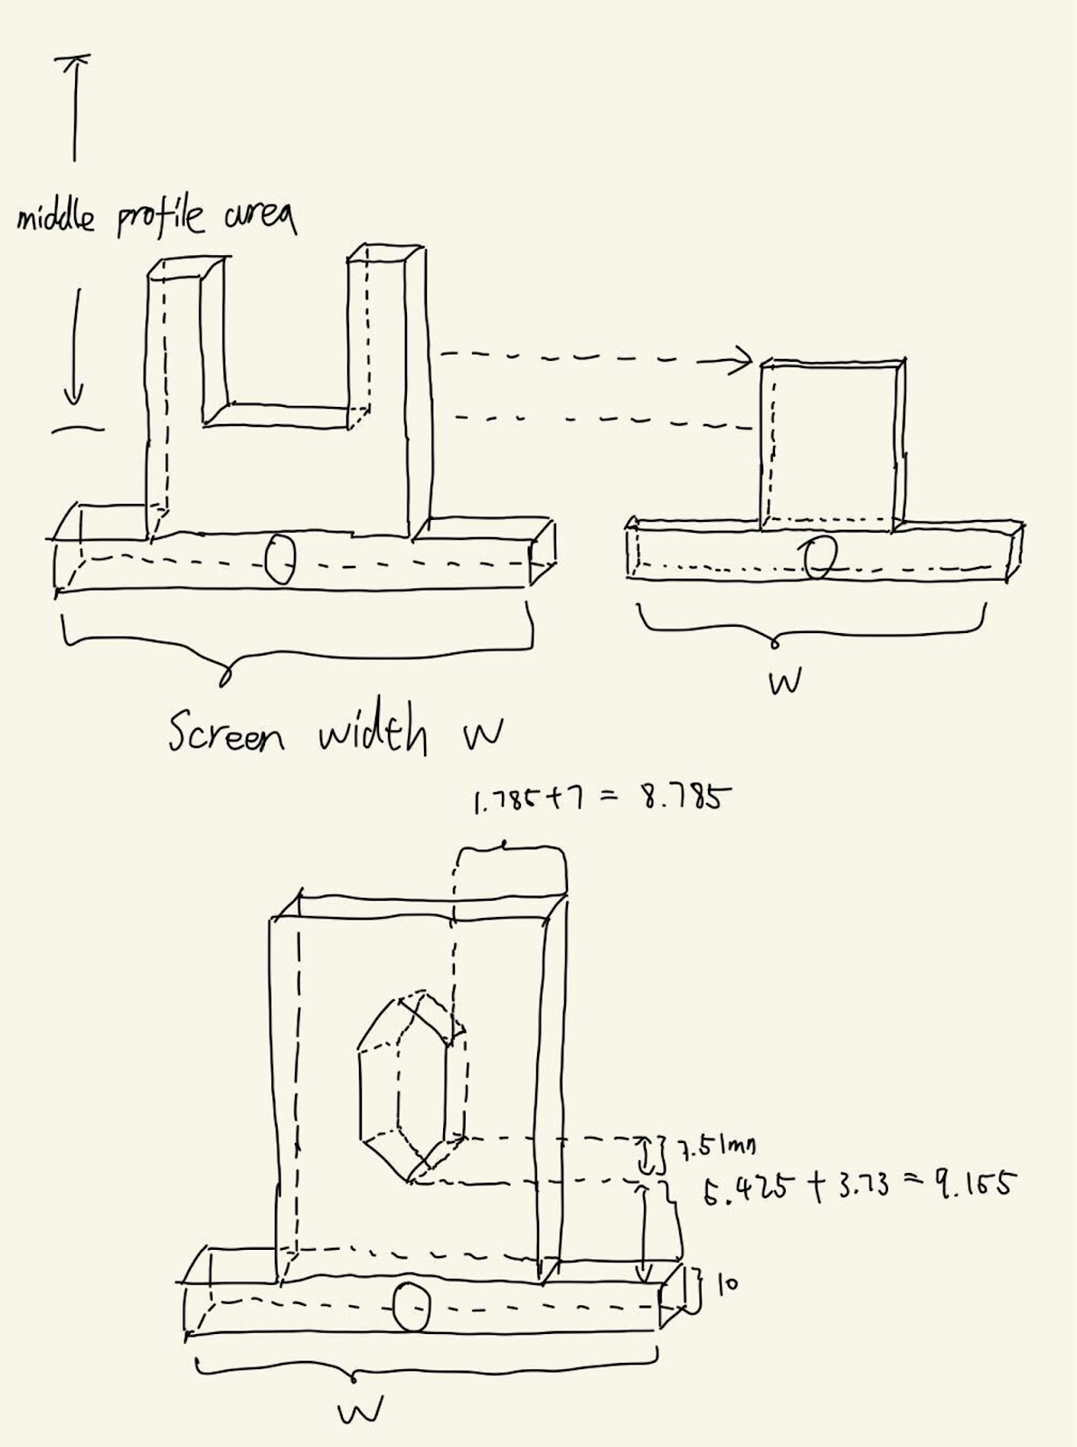
Recap: Water layer expr
modified holder

Slide 7
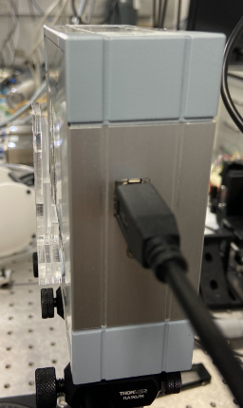
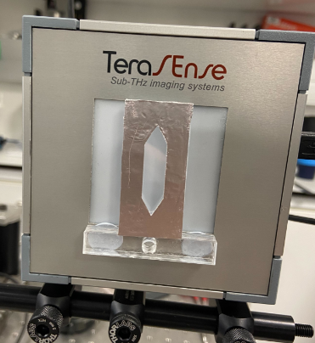
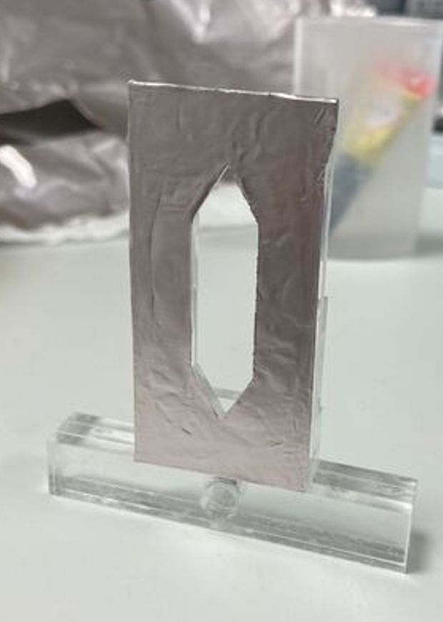
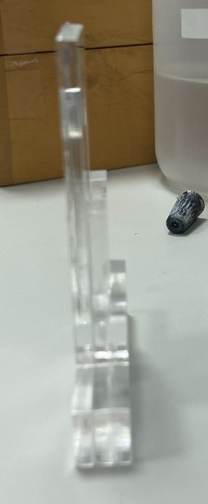
Recap: Water layer expr
modified holder

Slide 8
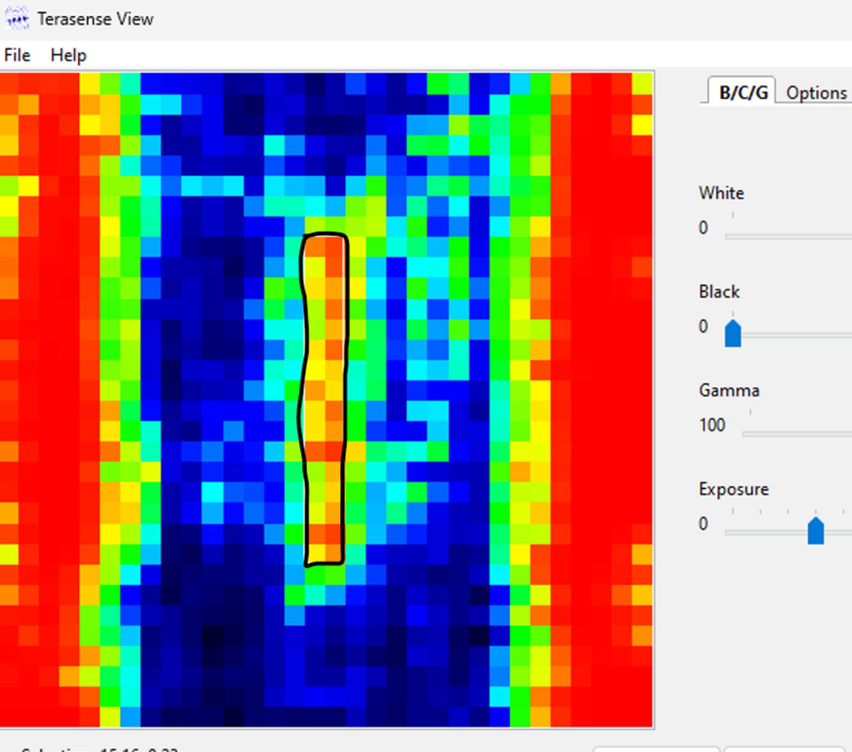
Recap: Water layer expr
Pixel by pixel scan result:
Standard Deviation of alpha: 7.54
Average of alpha: 49.56 (no negative value)
Expected alpha: 75~85

Slide 9
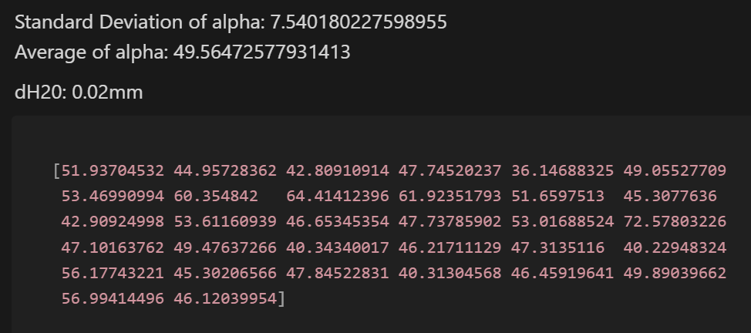
Recap: Water layer expr
Pixel by pixel scan result:
Standard Deviation of alpha: 7.54
Average of alpha: 49.56 (no negative value)
Expected alpha: 75~85

Slide 10
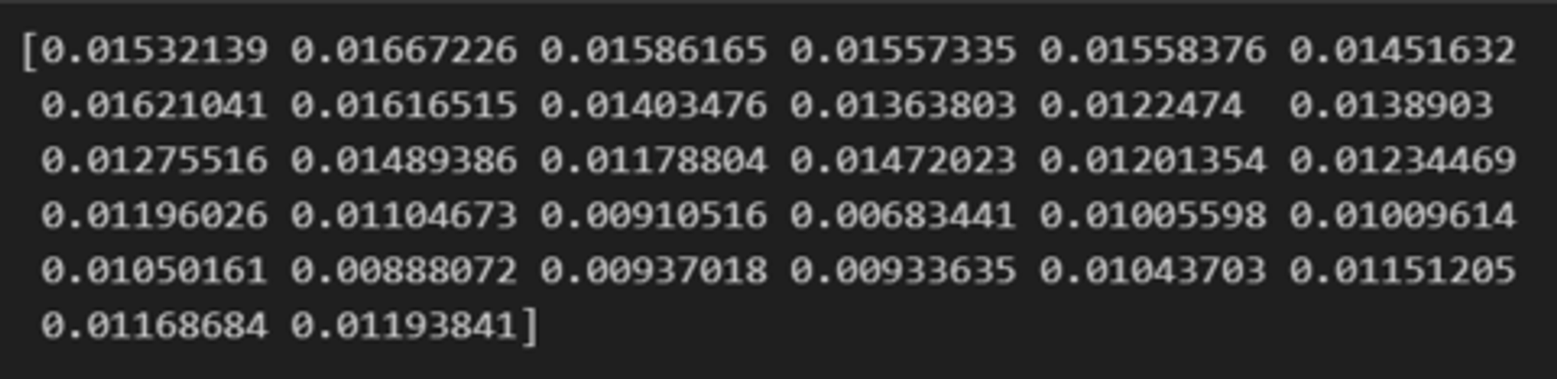
Recap: Water layer expr
Pixel by pixel scan result:
Standard Deviation of alpha: 7.54
Average of alpha: 49.56 (no negative value)
Expected alpha: 75~85
dH2O(0.013cm) calculated using the right alpha is very close to cuvette water layer thickness(0.020cm)

Slide 11
Recap: Water layer expr
Pixel by pixel scan result:
Standard Deviation of alpha: 7.54
Average of alpha: 49.56 (no negative value)
Expected alpha: 75~85
Although the results do not match the coefficients found in the literature, the data we obtained has no negative value and exhibits a similar pattern across various measurements.
Our primary focus is on the variation in water content in plants, so we should proceed to the next experiment.

Slide 12


Single Leaf Experiment
RWC: relative water content
This expr aims to measure the RWC of a single leaf with THz method and compare it to the standard technique(gravimetric method).
1. Gravimetric RWC: calculated through weight data
2. THz RWC : calculated through THz data
dH2O = (log(I_ref / I_smp) +0.1*log(10) * 5.8) / 85
Ideally, The THz RWC result, and the Gravimetric THz RWC result should show a similar pattern.
We can then use THz method to measure RWC for plants.

Slide 13
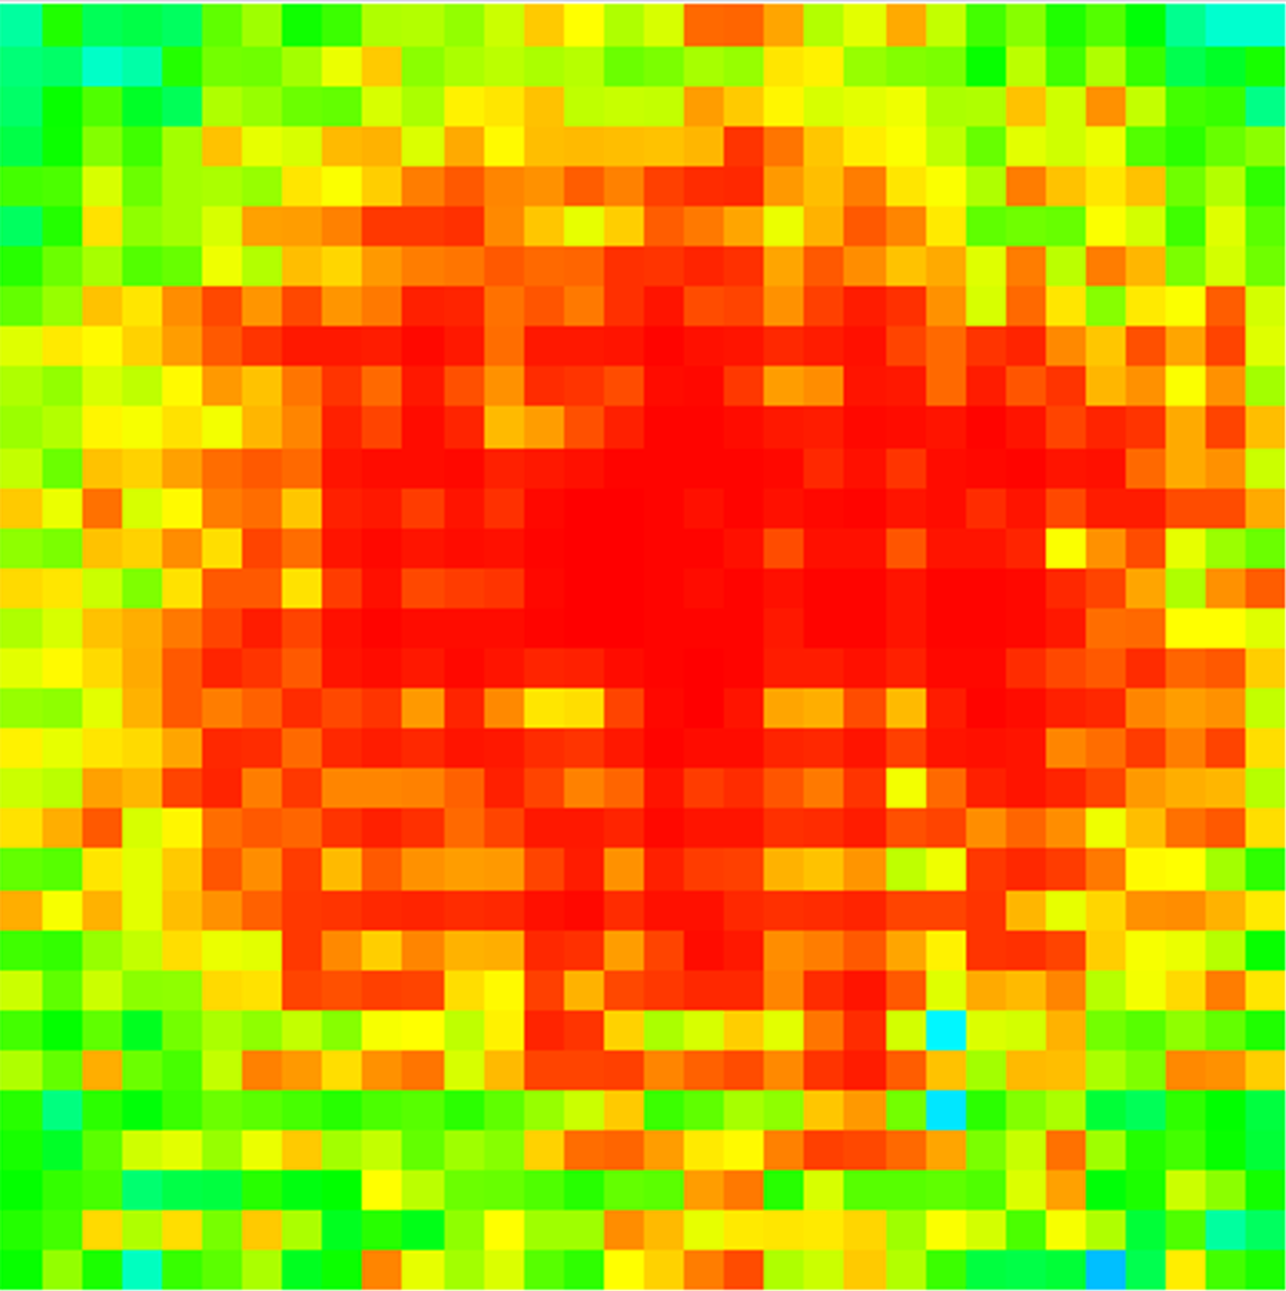
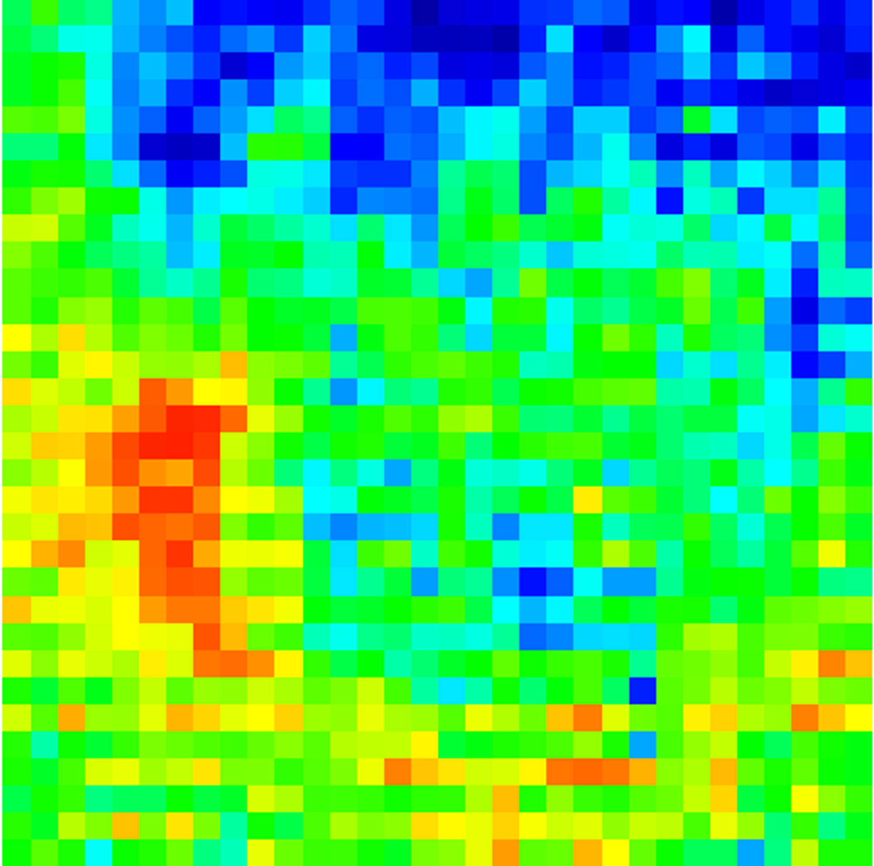
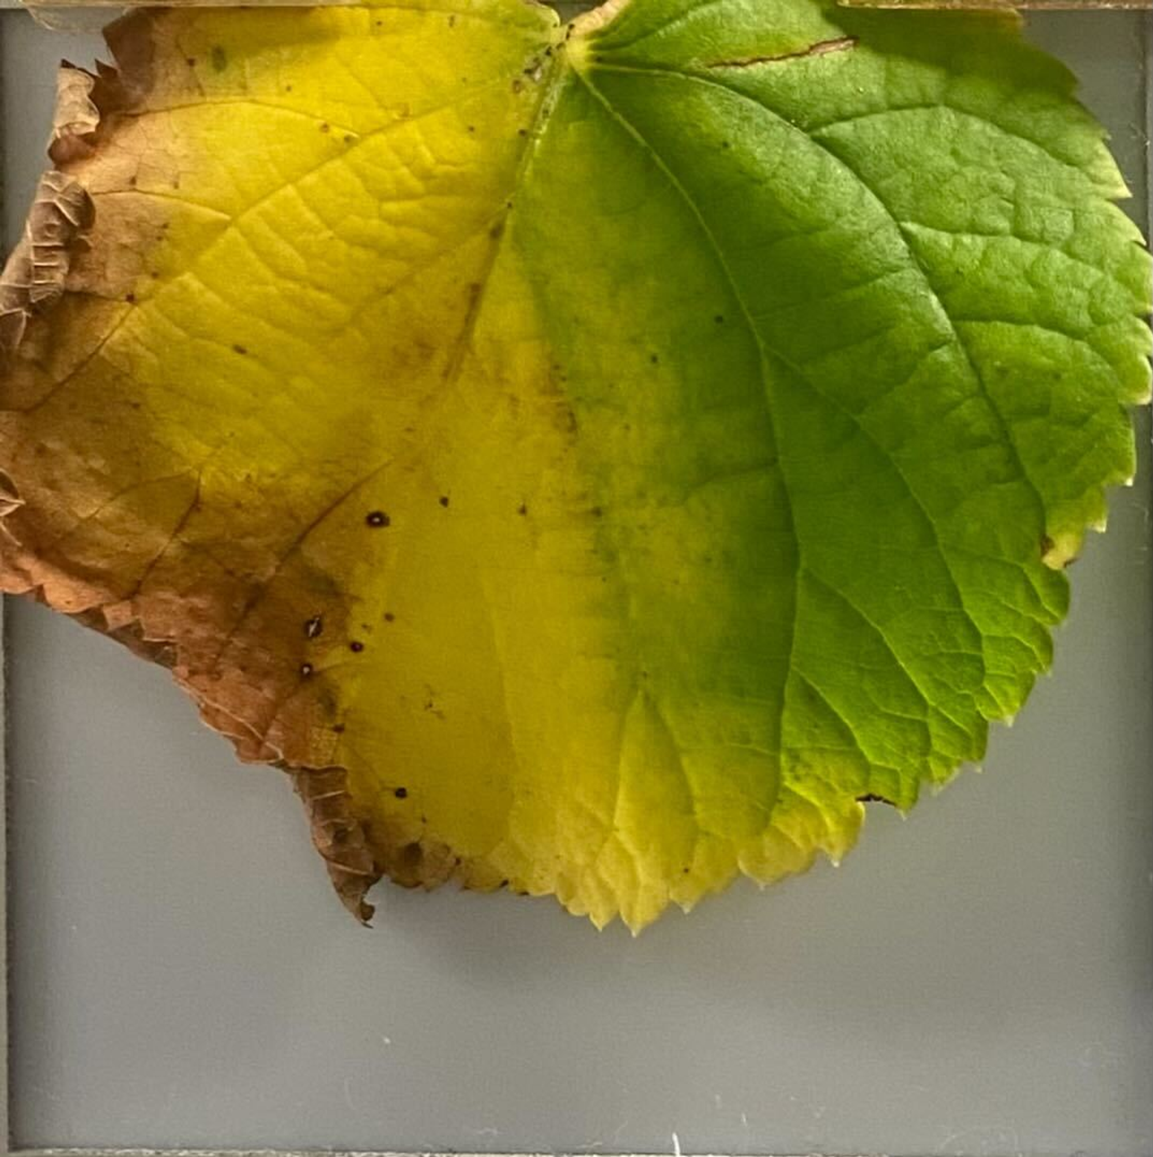
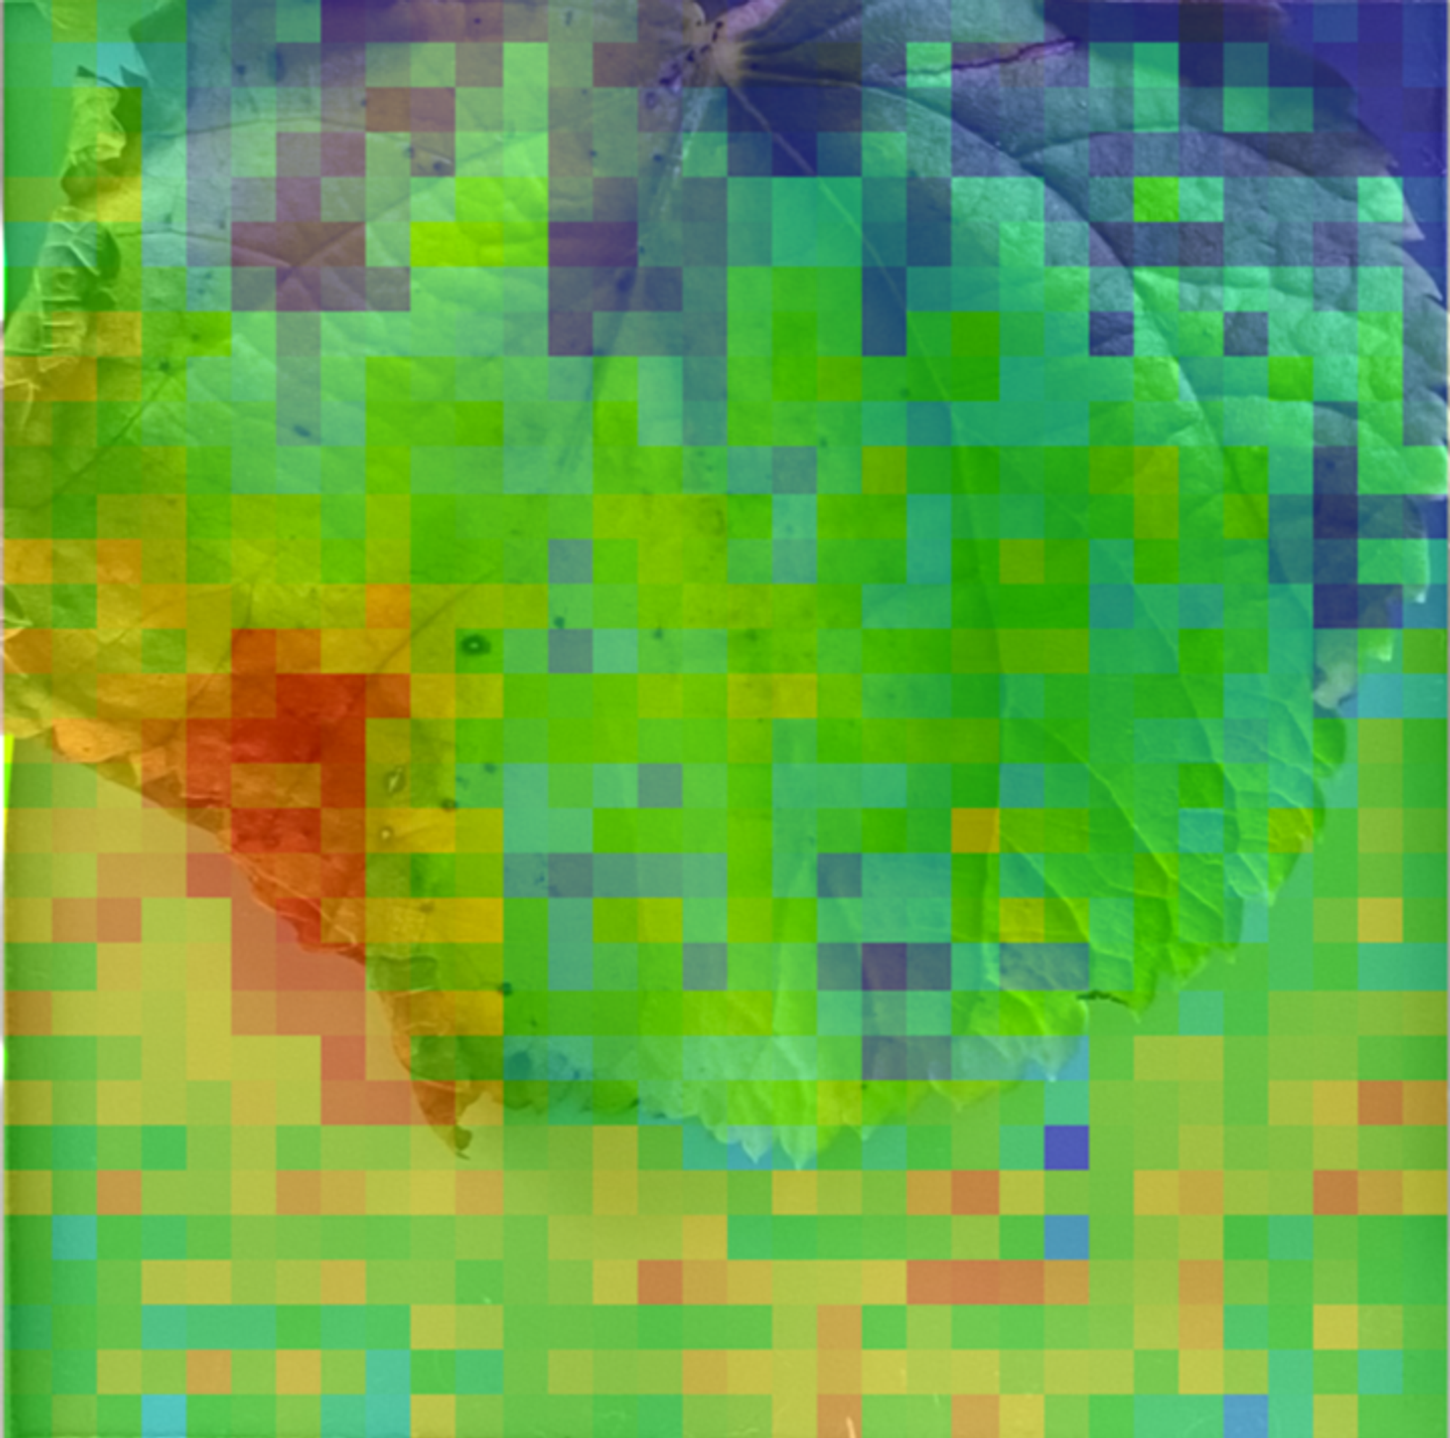
Single Leaf Experiment
1. Check if water in leaf can be distinguished from THz img
empty THz img
leaf THz img
real leaf img
real leaf&THz img
It is quite clear that the dry part of the leaf(yellow) is red and yellow, the watered part of the leaf is green and blue.

Slide 14
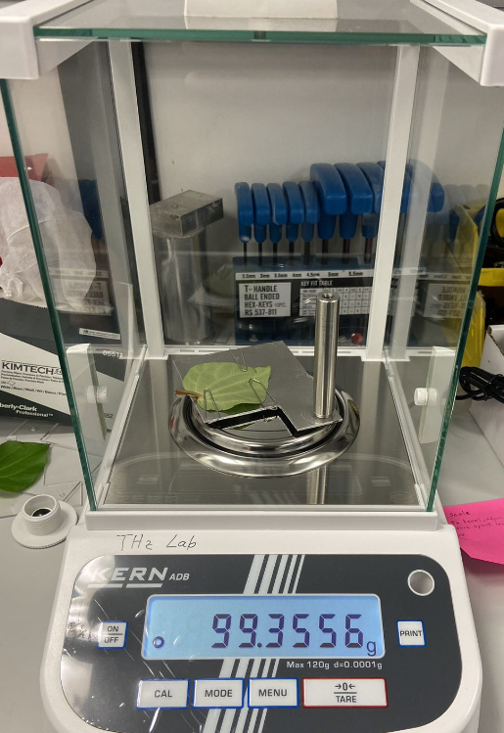
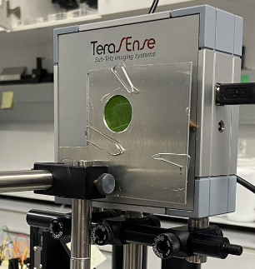
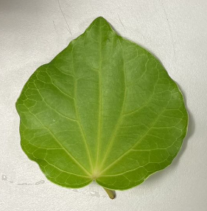
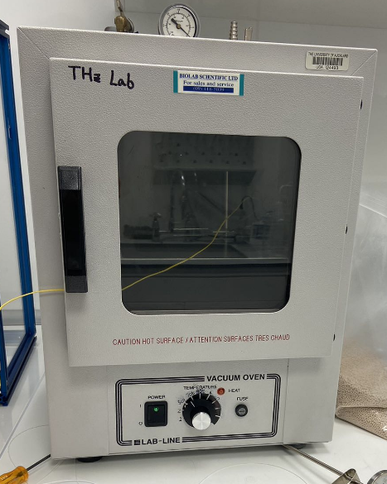
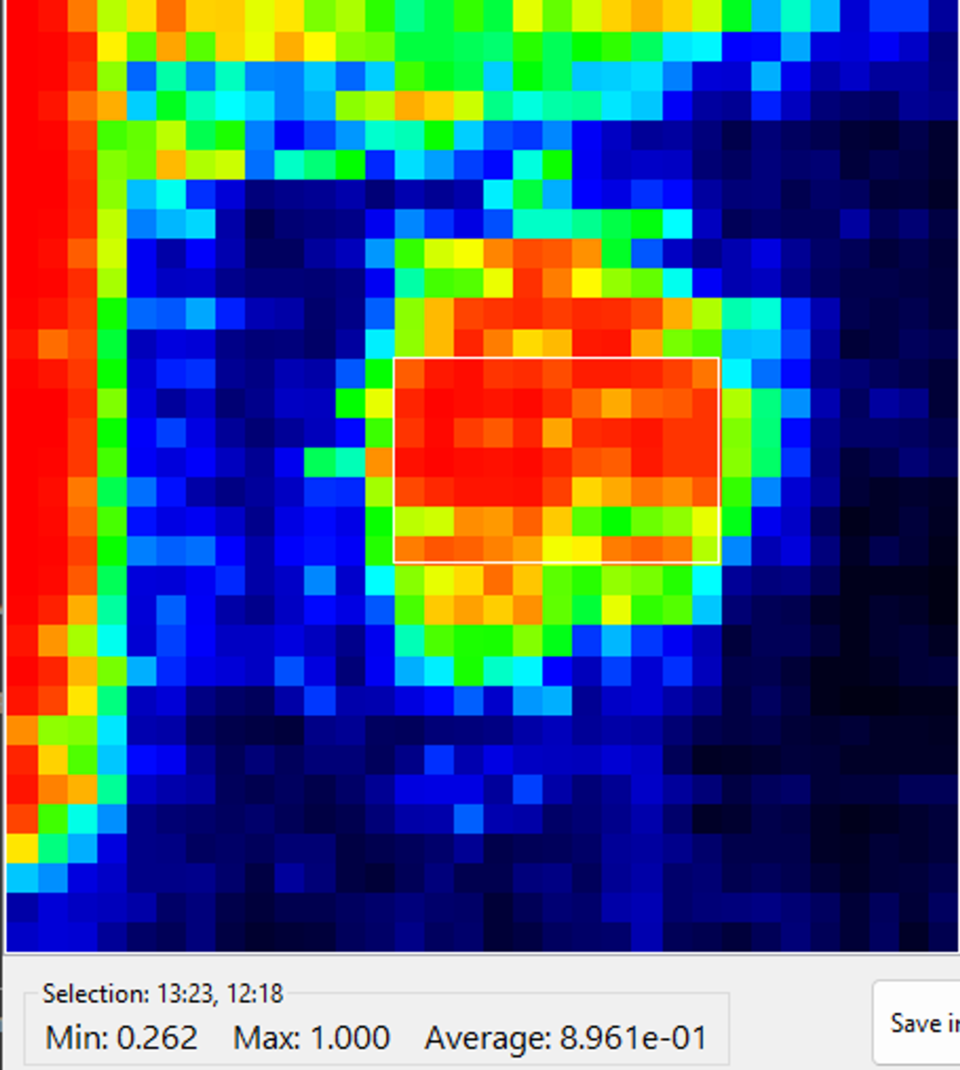
Single Leaf Experiment
2. Conduct experiment to get data
TW
Pixel value & Attenuation
Put the leaf in the oven to evaporate some water
Fully hydrate the leaf
Weight the leaf
Take THz data scan

Slide 15
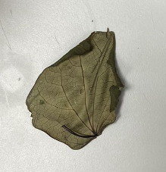
Single Leaf Experiment
2. Conduct experiment to get data
TW
Pixel value & Attenuation
Put the leaf in the oven to evaporate some water
Fully hydrate the leaf
Weight the leaf
Take THz data scan
W
Put the leaf in the oven to evaporate some water
Weight the leaf
Take THz data scan
Repeat until the leaf dries up
leaf dries up
DW
Weight the leaf
Take THz data scan

Slide 16
Single Leaf Experiment
3. Calculate RWC
1. Gravimetric RWC
W – Wet weight (Wet groups leaves data)
TW –Turgid weight (First wet group leaf data, with the freshest leaf)
DW – Dry weight (Dry leaf data)
2. THz RWC
dH2O = (log(I_ref / I_smp) +0.1*log(10) * 5.8) / 85
Wet group ~ Sample group
Dry group ~ Reference group
d_curr - Current water layer thickness
d_curr - Saturated water layer thickness

Slide 17
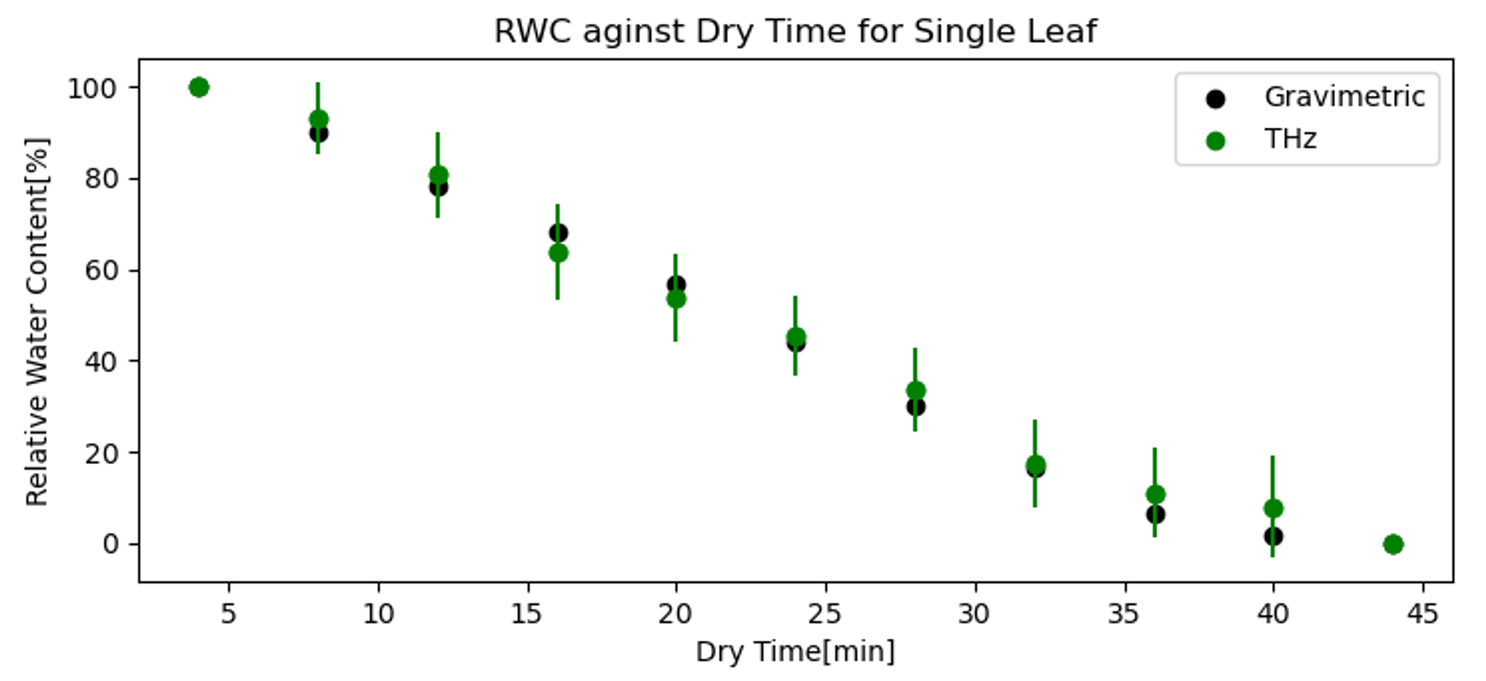
Single Leaf Experiment
4. Plot

Slide 18
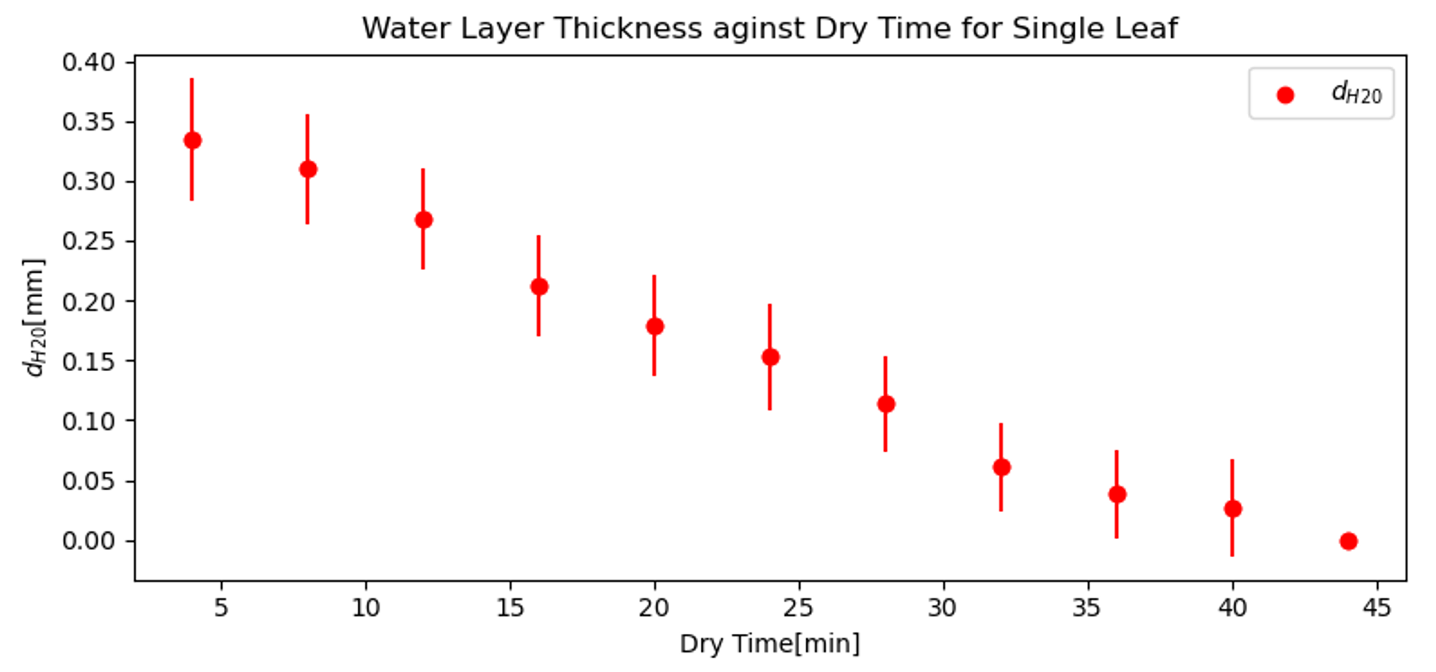
Single Leaf Experiment
4. Plot

Slide 19
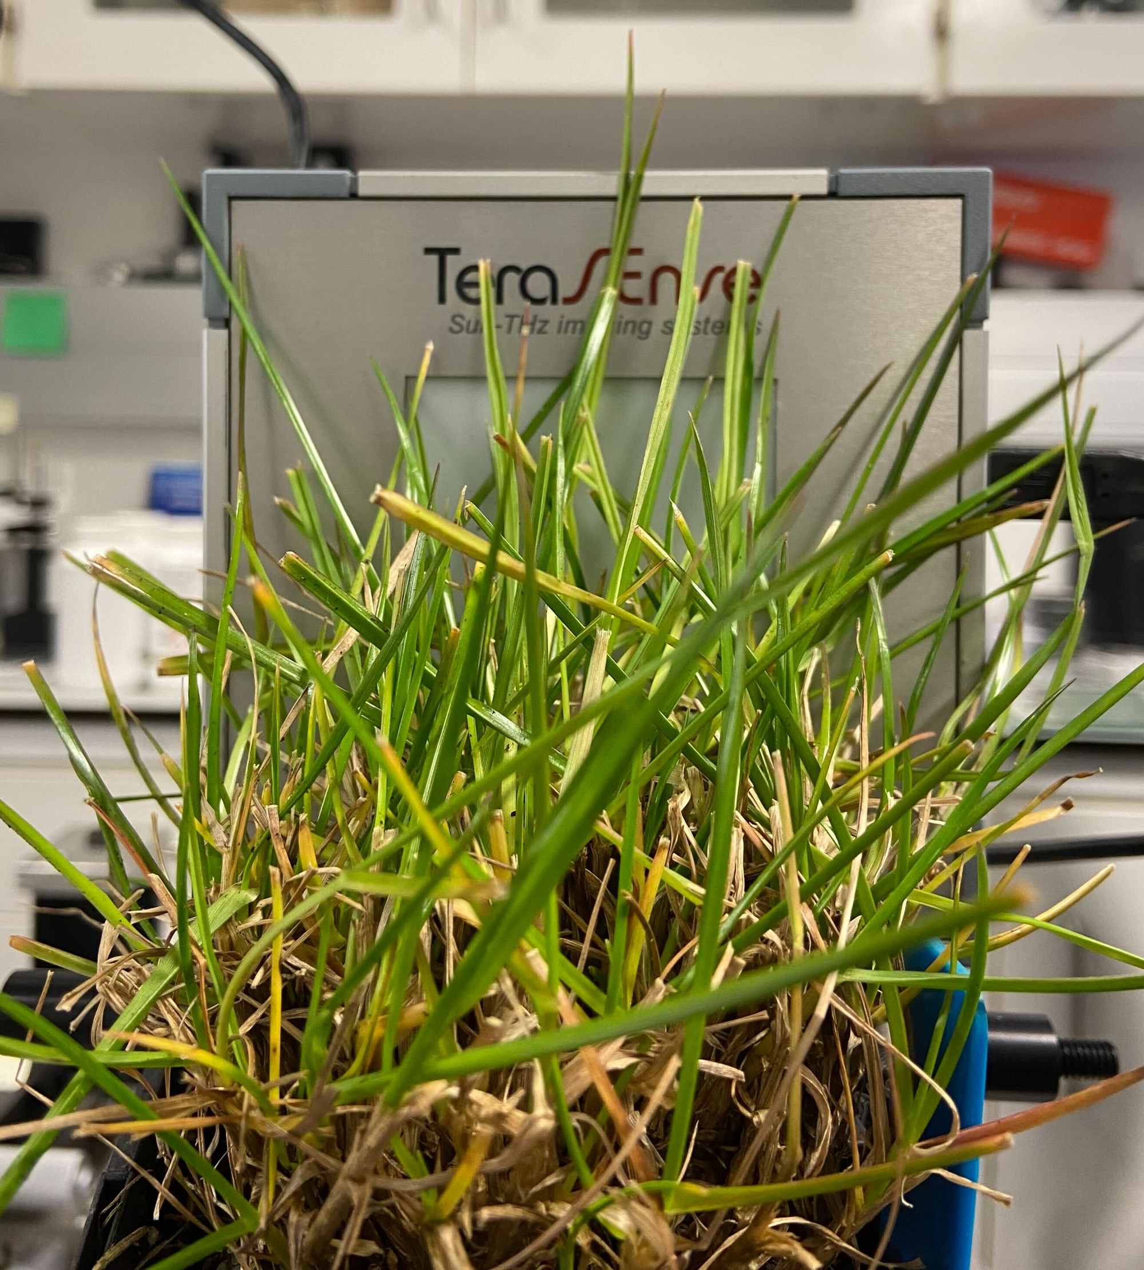
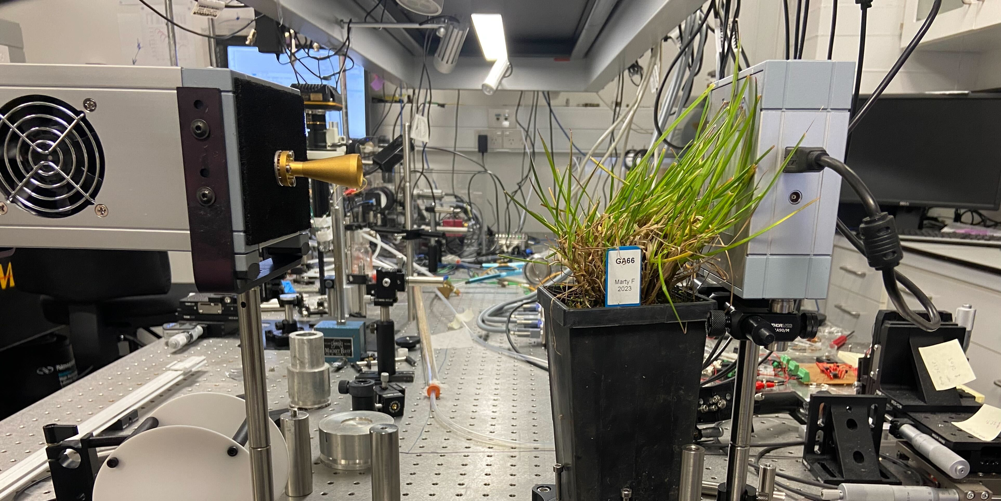
Plant Experiment
Repeat the leaf expr but on real plants
Plant experiment setup

Slide 20
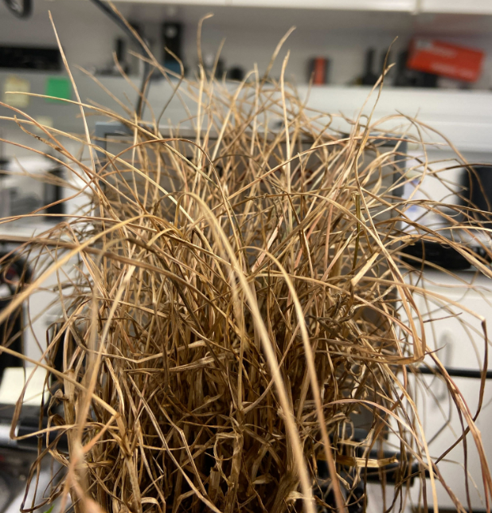
Plant Experiment
Wet plant ~ Sample group
Dry plant ~ Reference group
Drying method: Naturally dehydrate and take one THz scan daily for each plant.
Weighting method: Cut off some leaves from each plant and measure their current weight, fully wet weight and fully dry weights to calculate the gravimetric RWC.

Slide 21
Plant Experiment
Experiment process
Repeat until plants dry up
Leaf with around 80% RWC
Cut some leaf from the plant
Take THz data scan
Leave for one day to de-hydrate
Weight the leaf
W
Fully hydrate the leaf
Calculate the gravimetric RWC and THz RWC
Weight the fully hydrated leaf
TW
Fully de-hydrate the leaf
Weight the dry leaf
DW

Slide 22
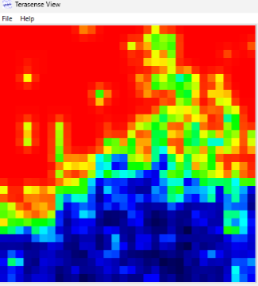
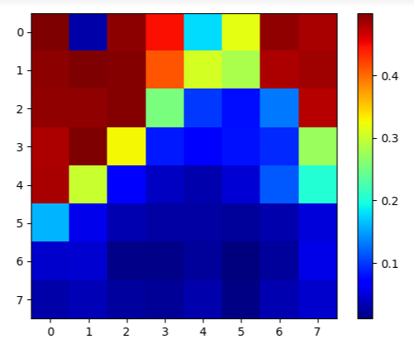
Plant Experiment
Scan time
There are 1024 pixels in total, may take 4-5h or so to do one pix-by-pix scan(find the almost saturated attenuation for every pixel).
We use a 4*4 grid group average as one, so 1024 pixels are simplified to 64 pix-groups

Slide 23
Plant Experiment
Pixels with no leaves
Some pixel have no leaf in front of them, this will bring noise to the data

Slide 24
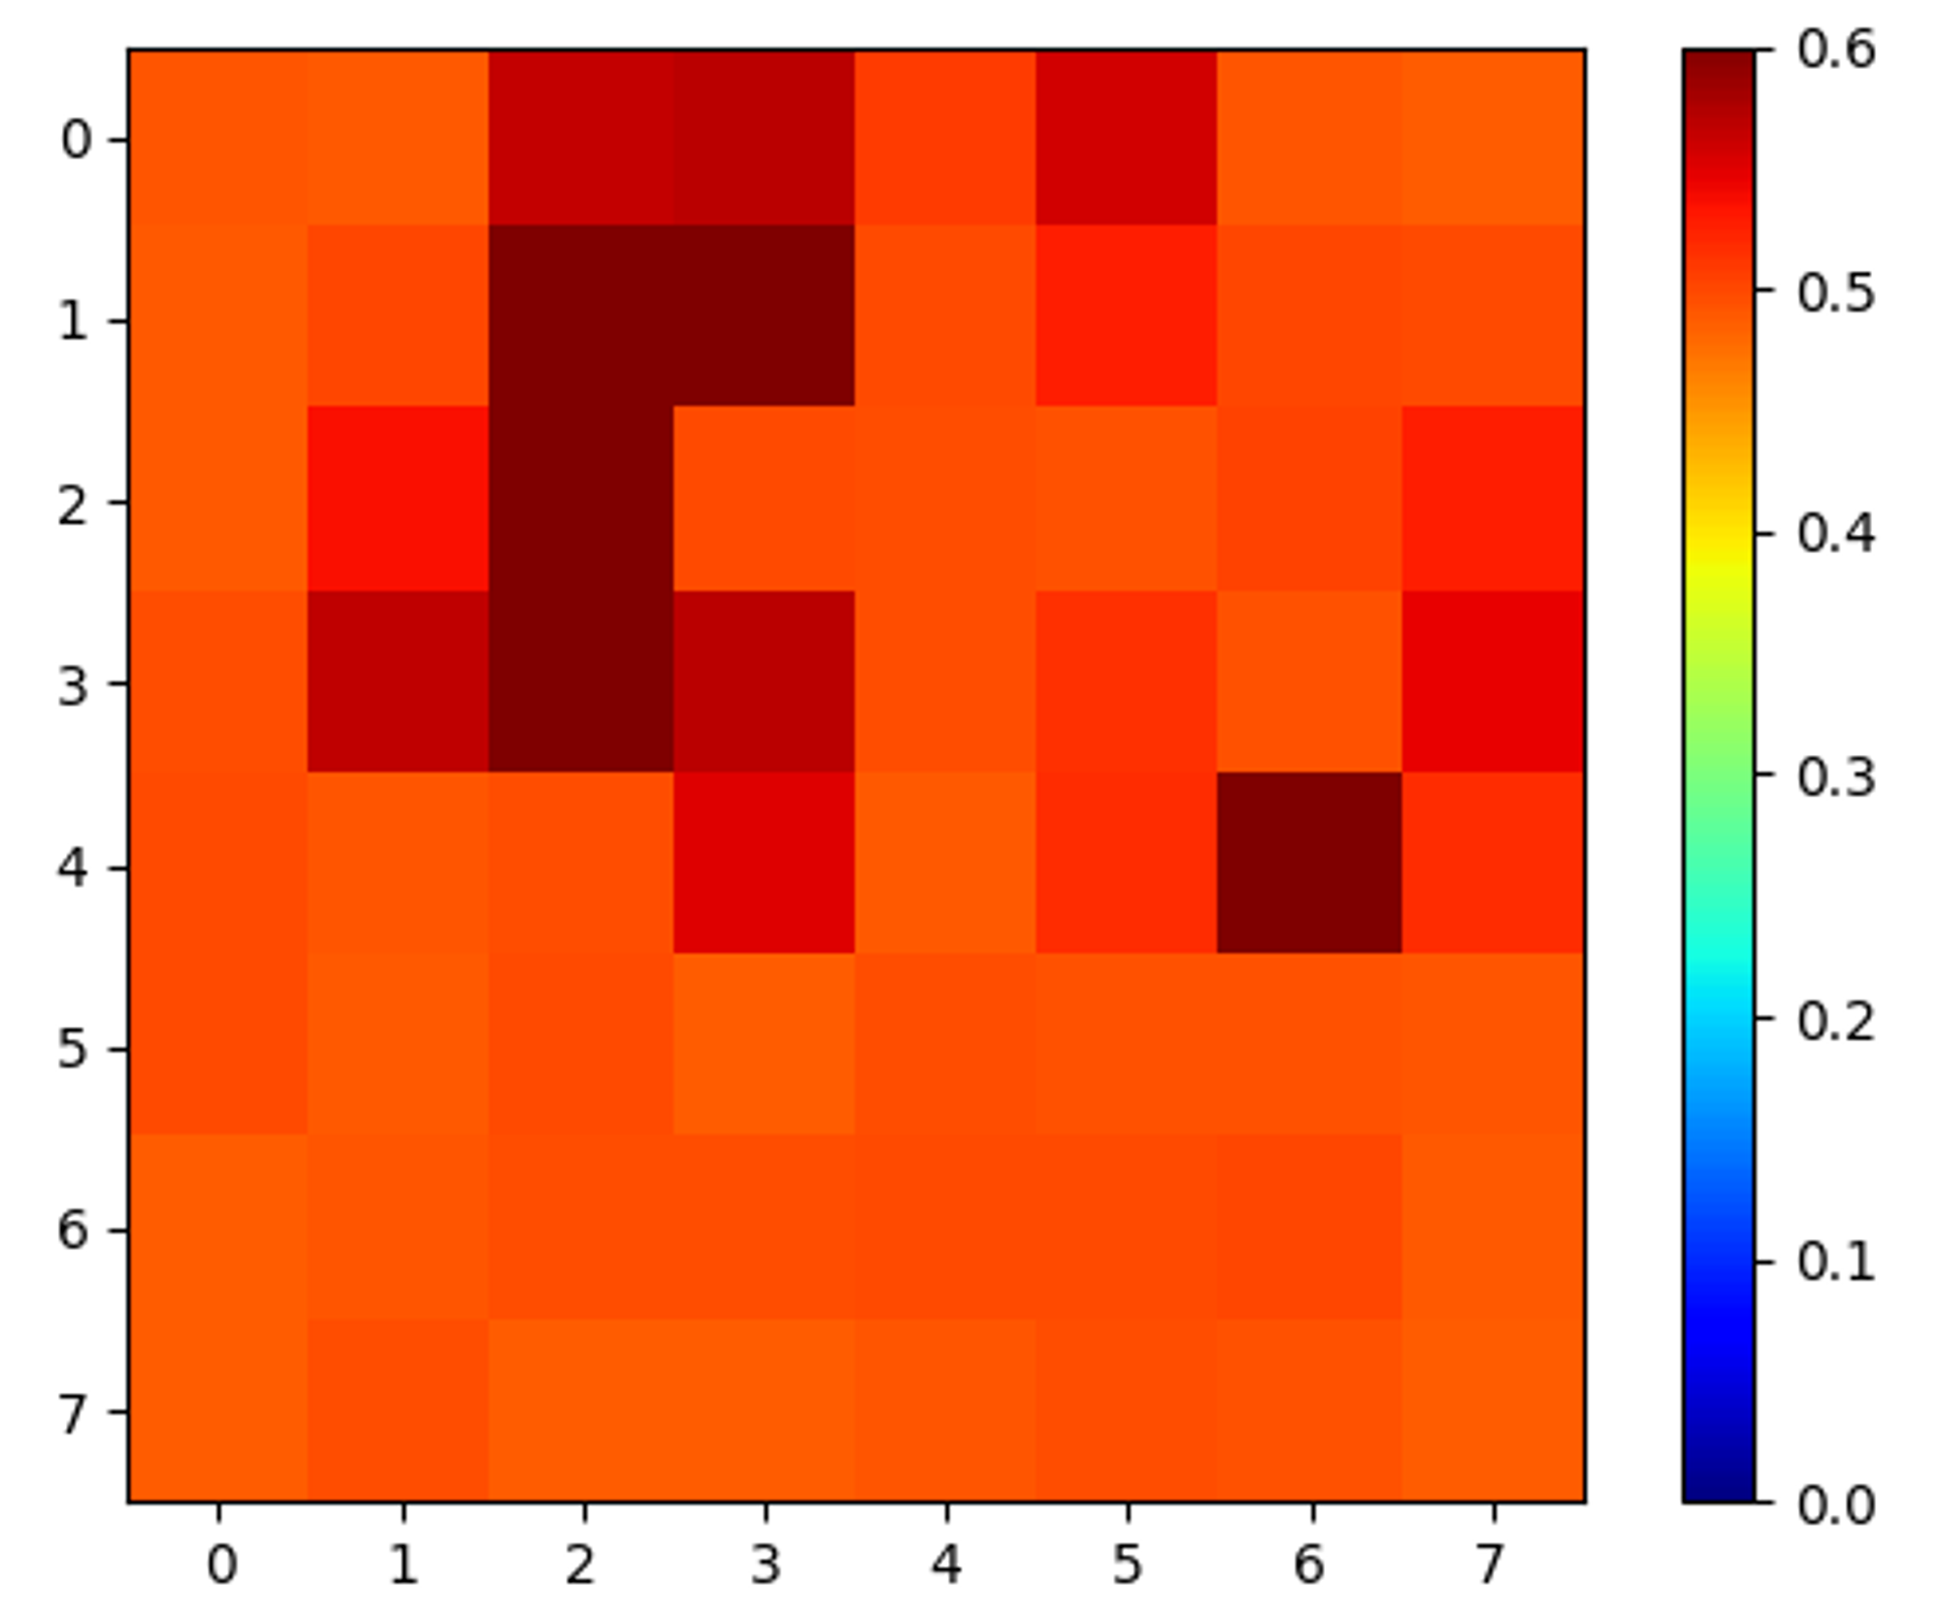
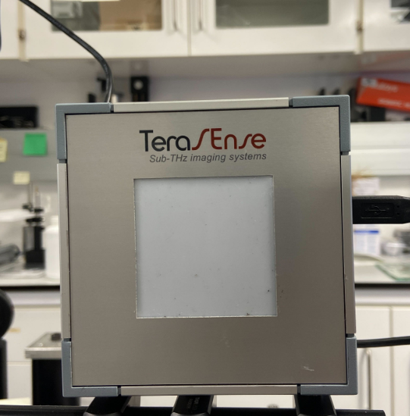
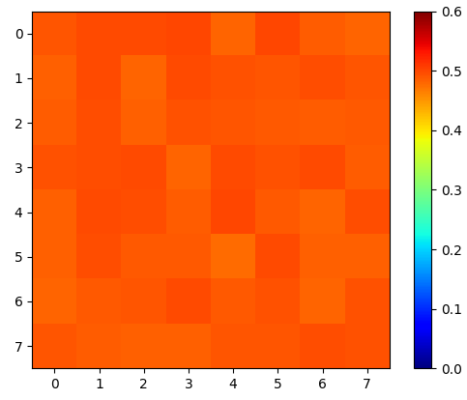
Plant Experiment
Difference between empty screen and dry plants
Average saturated attenuation: 6.45625 dB
Average pixel value: 0.493481125
Average saturated attenuation: 10.49375 dB
Average pixel value: 0.49057878125
Dry plants One50
Empty screen
The difference is significant, so we can try setting attenuation threshold to exclude empty pixel

Slide 25
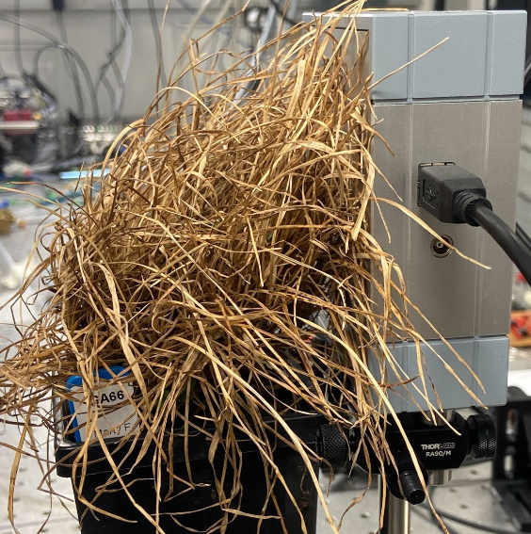
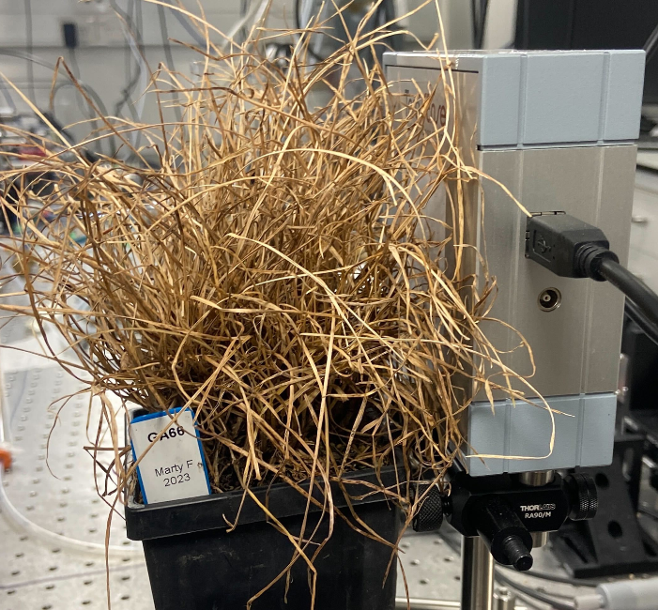
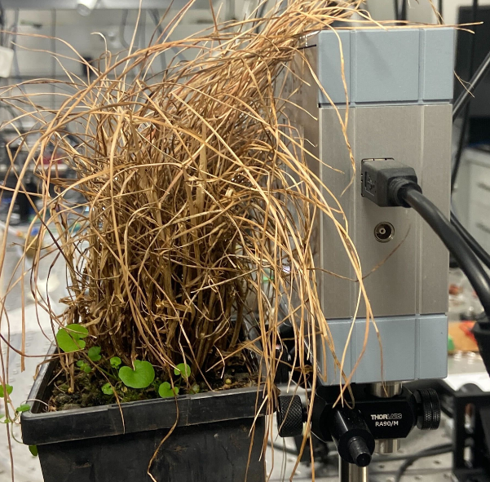
Plant Experiment
Dry plants GA66-1:
Average saturated attenuation: 8.875 dB Average pixel value: 0.49133940625
Dry plants GA66-2:
Average saturated attenuation: 9.1125dB Average pixel value: 0.491919609375
Dry plants One50:
Average saturated attenuation: 6.45625 dB
Average pixel value: 0.493481125
Empty screen:
Average saturated attenuation: 10.49375 dB
Average pixel value: 0.49057878125
Two GA66 plants have similar data, so saturated attenuation may be related with specious.

Slide 26
Problems
To fully exclude un-wanted pixels(empty pixel)
Get data first and then use attenuation threshold to exclude outliers
or
Check how the pixels are aligned with the screen, and exclude empty pixel before collecting data with real images

Slide 27
Outlook
Solve pixels with no leaves issue.
Collect complete plant experiment data.

Slide 28
Thank you!

